Slide 1

VGECIAN
Theme :- Ed-Tech
Tirth Patel
Amit Gohel
Deep Suthar
Pruthvi Gediya

Slide 2
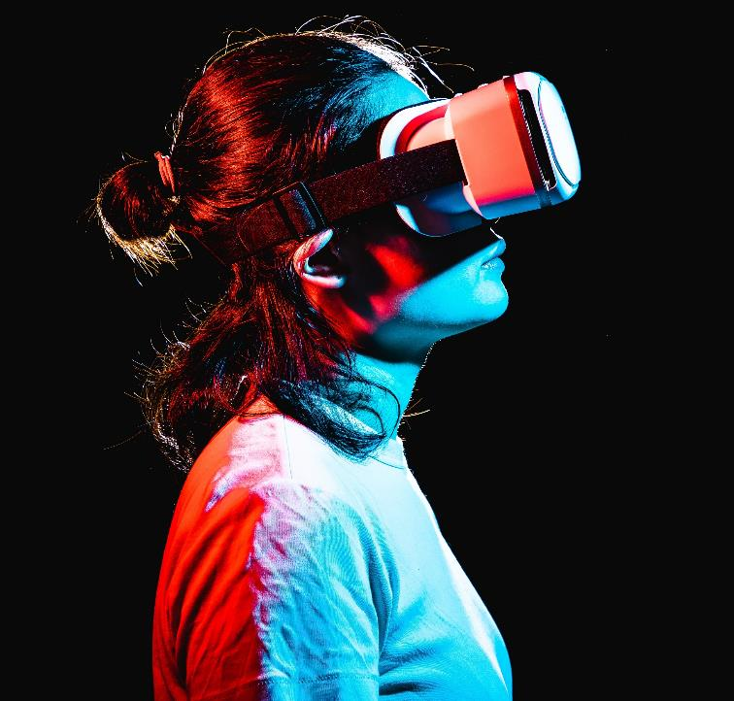
What Is saransh?
Saransh, derived from Sanskrit language means Summary. It is a hardware + software based project which provides a summary of lengthy section.
It will give summery for people who are Illiterate and students.

Slide 3

PURPOSE OF OUR PROJECT
Contoso​
In the routine life, some student have language barriers.
There are so many peoples who don’t have eye sight, they face whereas type of problems in there daily routine life like reading problem, so we design a system which name is saransh.
We are also focusing on illiterate peoples.
For those who want read book/novel/news papers but they haven’t time in there day to day life.

Slide 4
Tools and technology
Raspberry
Micro camera
Speaker
Python
natural language processing
pyttsx3

Slide 5

Body
First of all we will capture an image.
Then we will convert that image text in to a string.
After that we will use natural language processing to get summarise string.
Then we will convert that string into different language text.
At the end, we will convert text into voice

Slide 6
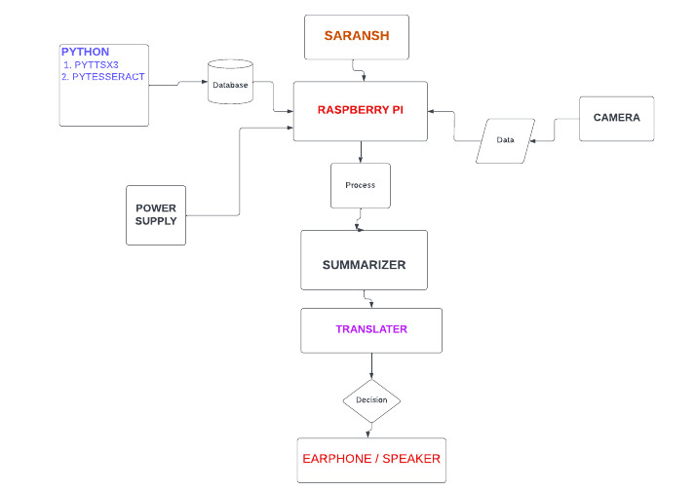
Flowchart

Slide 7

Conclusion
Using this immersive system we convert lengthy selection into summary and we will listen it in our needful language.

Slide 8

Thank you

